Slide 1
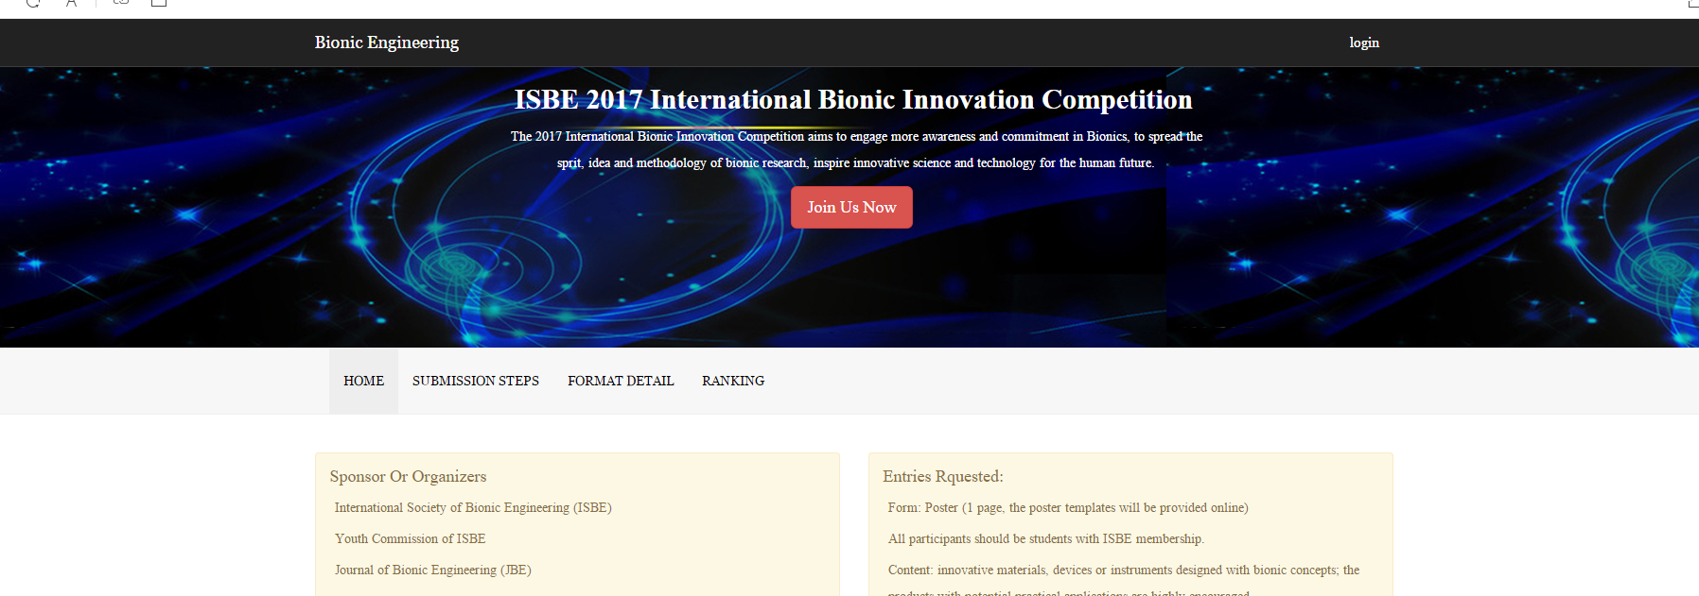
Step1. Go to the website of http://tgxt.isbe-online.org/ and click Join Us Now;

Slide 2
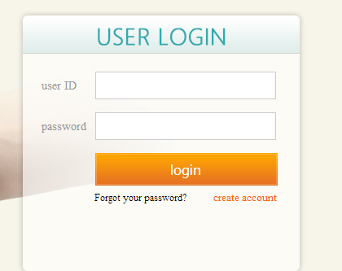
Step2. Click step one to create or login your account and click step two to download file templates to compile and present your work ;

Slide 3
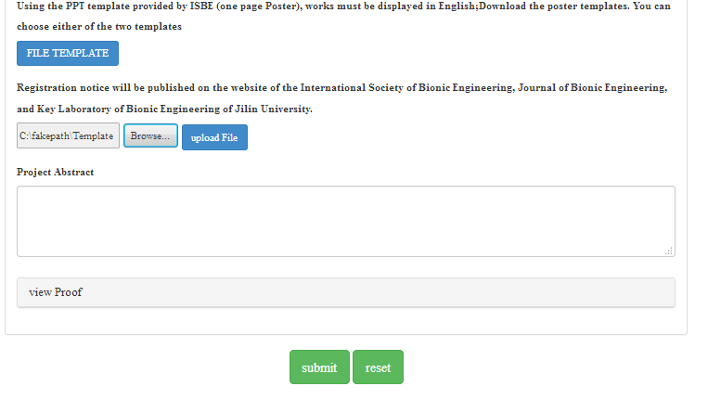
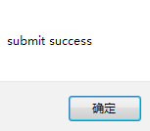
Step3. When login your account, please Click submit to fill your information and upload the file.
Step4. Please fill your information, click Browse to find your work file and click upload. When your file has been successfully uploaded, you can click “submit” to complete the whole process.
Group/Individual Abstract is about the Abstract of the work, while Project Abstract is about the whole ideal and the novelty of your work which can be worked as a cover letter for the reviewers

Slide 4
Step5. When the submission is done, please reload the webpage and you will get a File ID number, by which you can track your work.
Click “View Proof” to prove your submission.

